Slide 1
Computational Intelligence for
Transportation applications

Slide 2
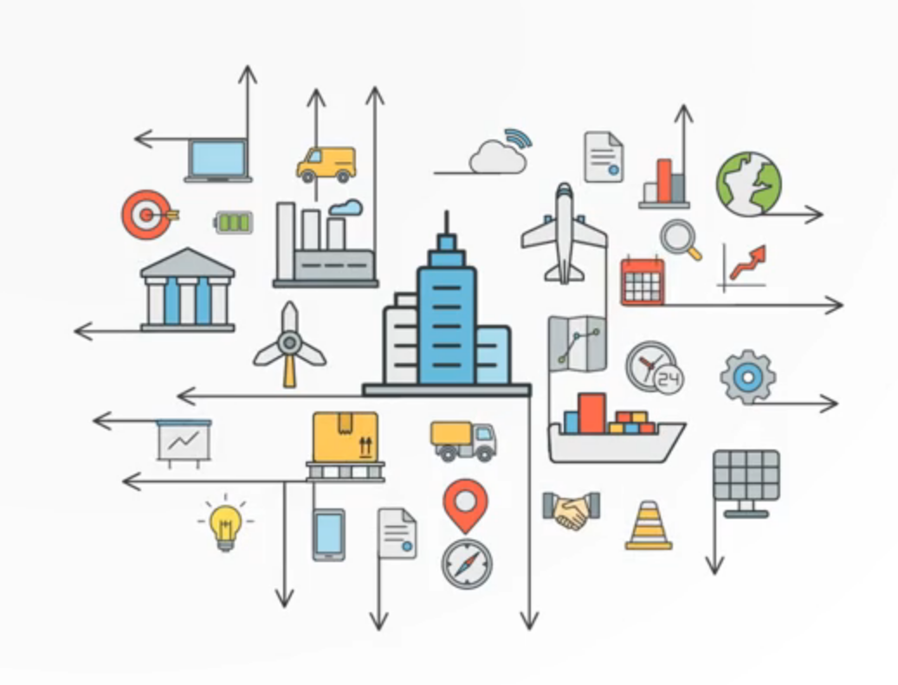
Outline
Computational Intelligence(CI)
Traffic and Transportation Problems
Application of VRP
Conclusion

Slide 3

1. Computational Intelligence (CI)
CI
A set of nature-inspired computational methodologies
to address complex real-world problems
Transportation Problems
In CI
The models and tools of
intelligence capable
inputting data,
processing them, and
producing expected results
Source: http://ci.cs.up.ac.za/

Slide 4
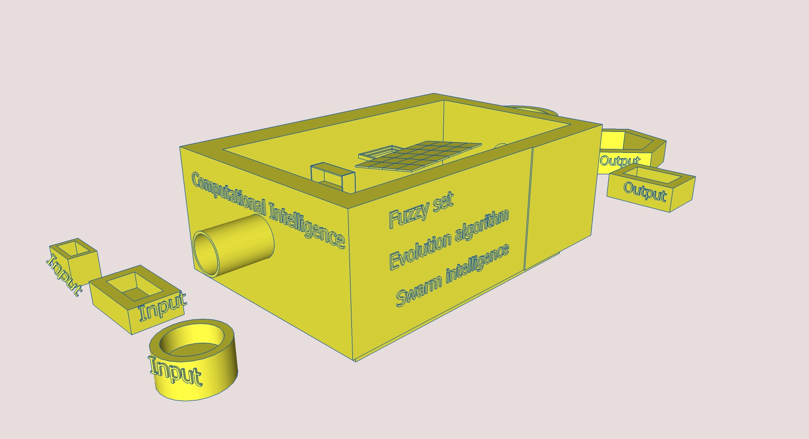
Study CI (cont.)
CI is like black box
Input ( Transportation problems)
Output (Optimized results)
Methodologies: FL, EA, SI

Slide 5
Study CI (cont.)
Some popular frameworks
Meta-heuristics | Fuzzy Logic
Genetic Algorithms Simulated Annealing Tabu Search Scatter Search Ant Colony Optimization Particle Swarm Optimization Differential Evolution Variable Neighborhood Search Adaptive Memory Programming …
 | Neural Network

Slide 6
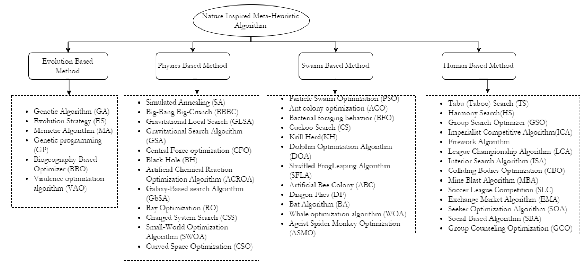
Classification on metaheuristics

Slide 7
Advanced CI (cont.)
For the complex and dynamic environments like Transportation
Computational intelligence could bring about
flexibility,
autonomous behavior, and
robustness against
topology changes,
communication failures and
scenario changes.
The potential CI offer
really significant in
collaboration and
development for applications
Source :http://www.ece.ncsu.edu/research_info/images/subareas/77.jpg

Slide 8
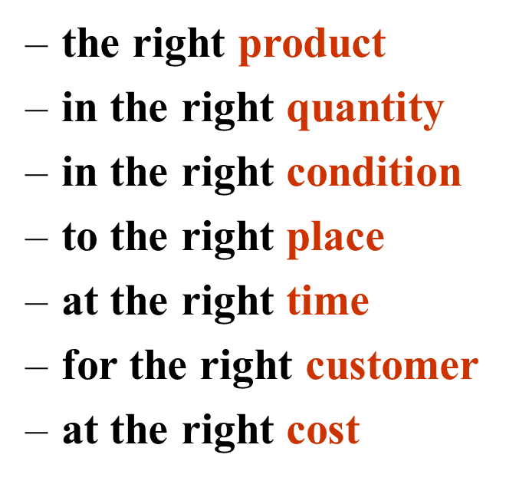
Advanced CI (cont.) aims
Cost reduction
(variable costs)
Capital reduction
(investment, fixed costs)
Service Improvement
(may be at odds with the above two objectives).

Slide 9
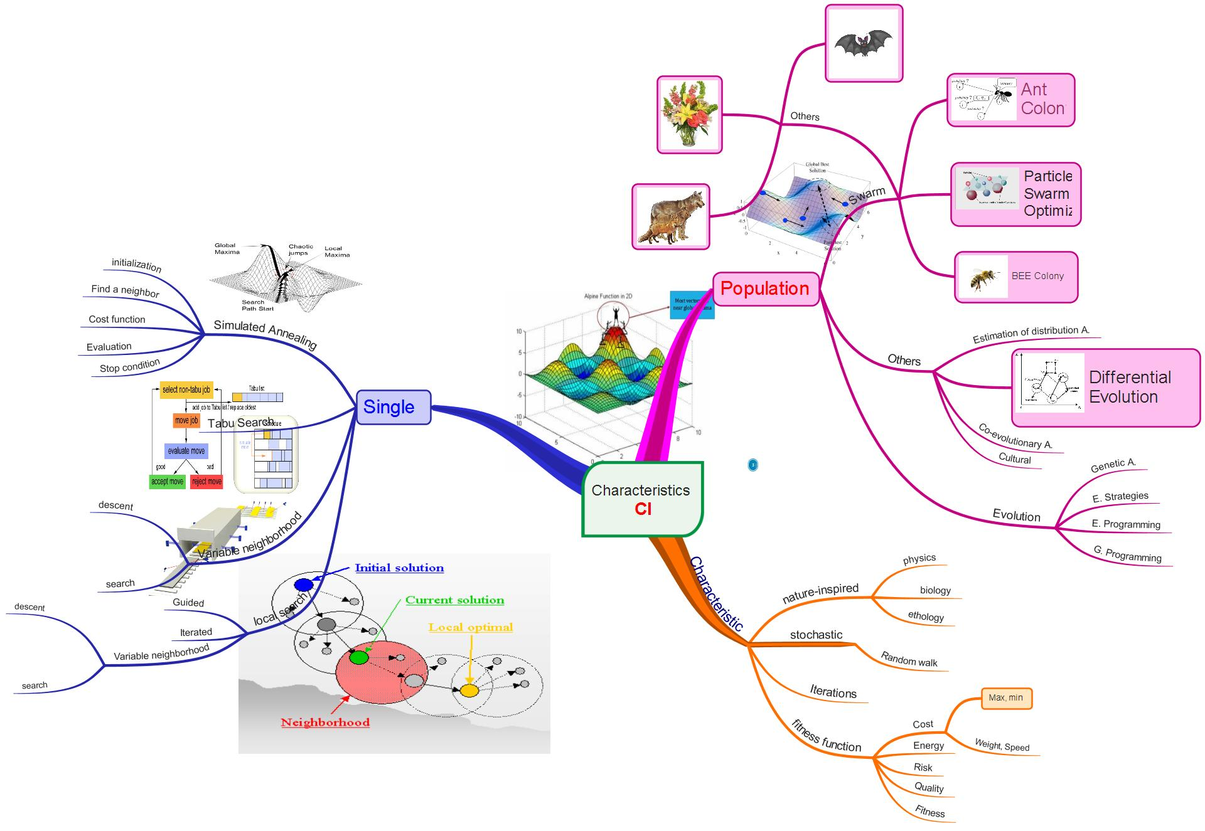
Features CI(cont.)

Slide 10
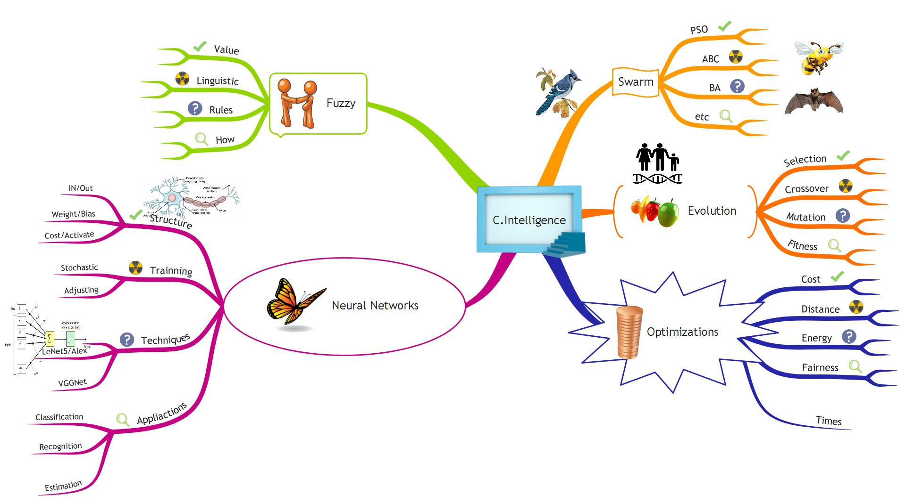
The state of the Art of CI

Slide 11
Some popular applications
Source: OptaPlanner

Slide 12
Example of Applications

Slide 13
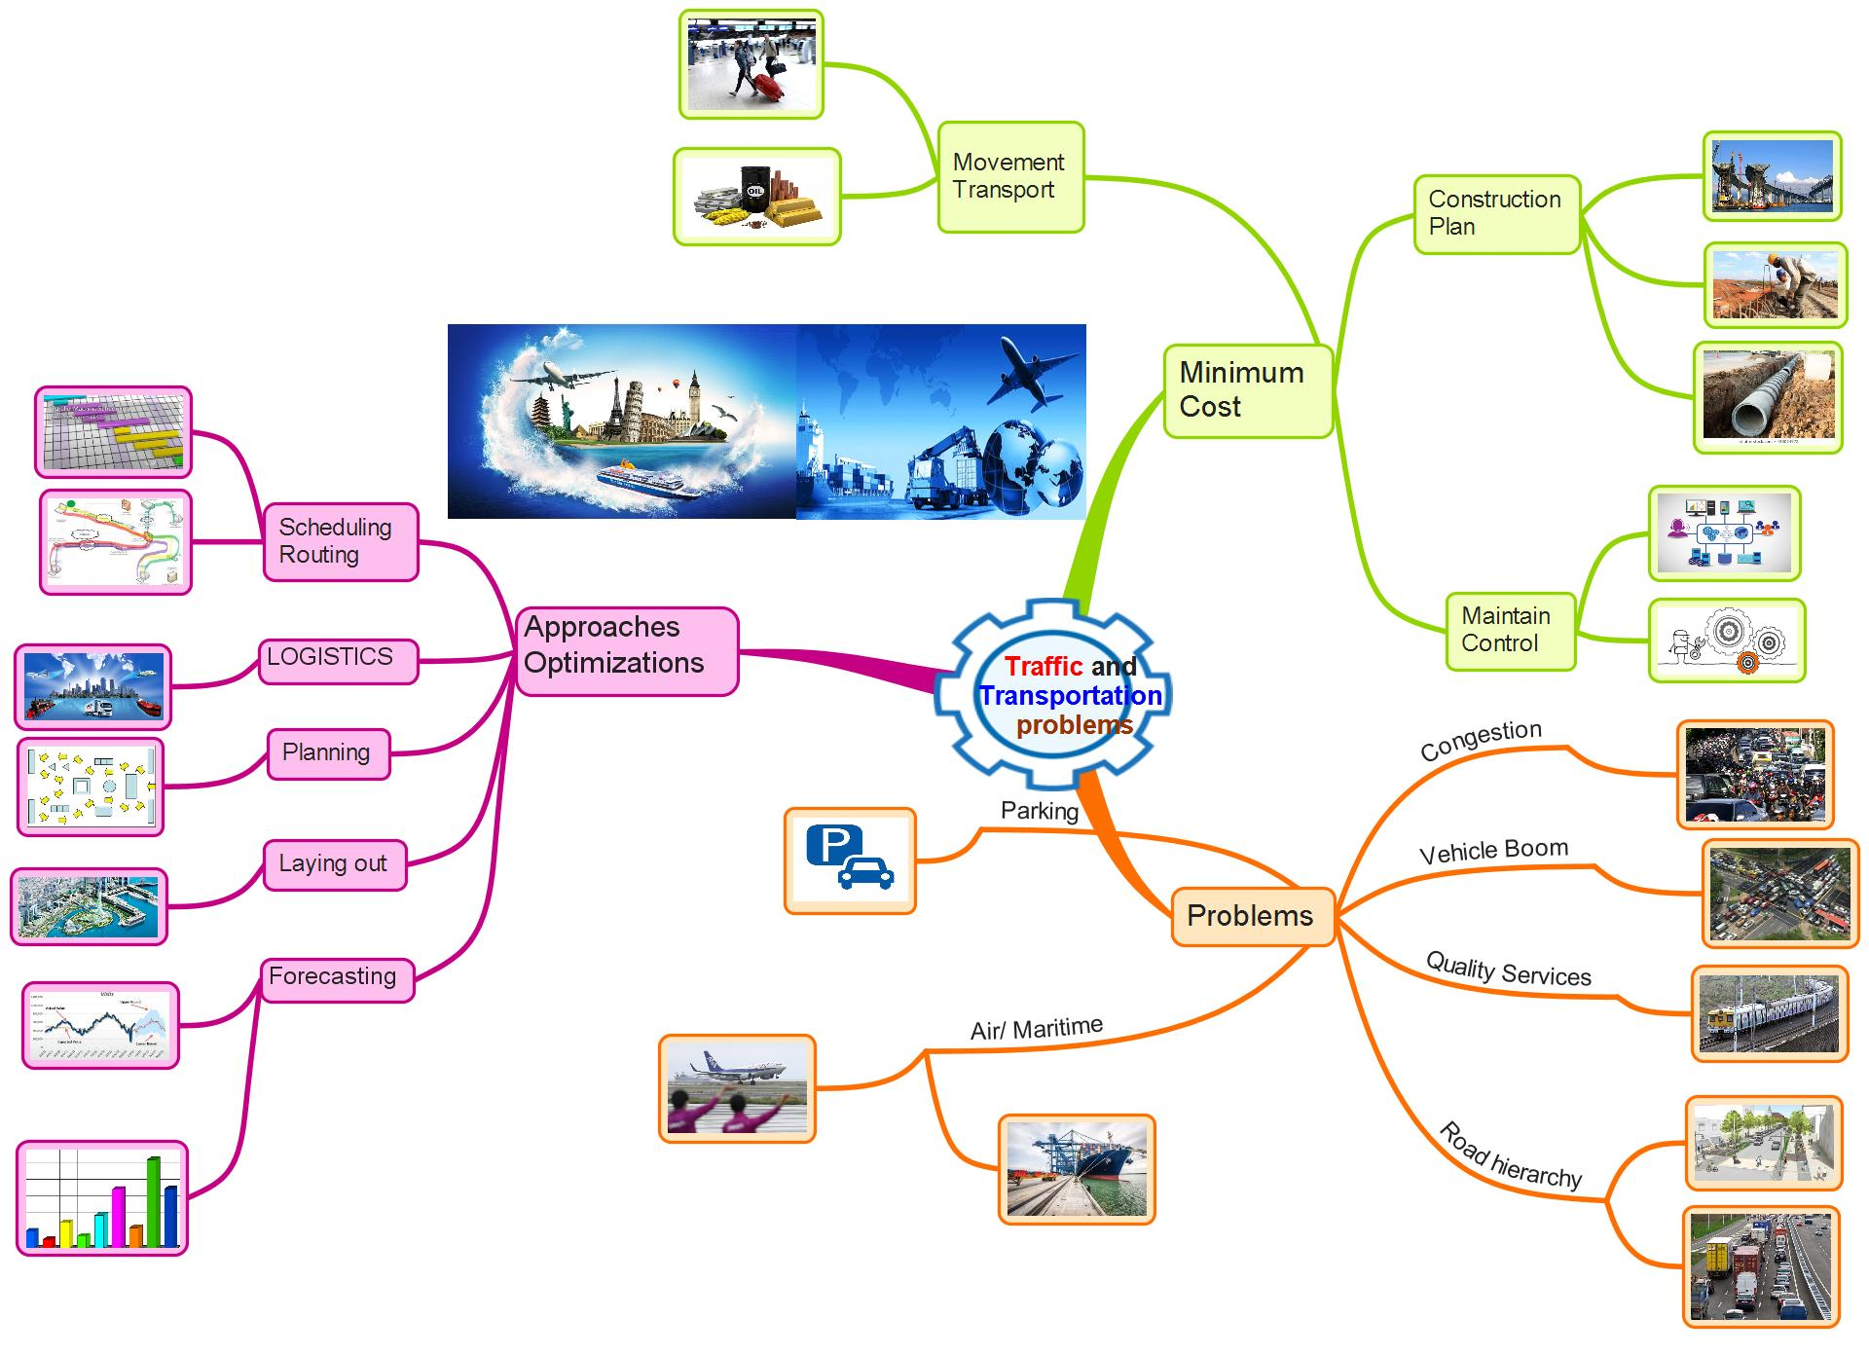
2. Traffic and Transportation Problems (TTP)

Slide 14
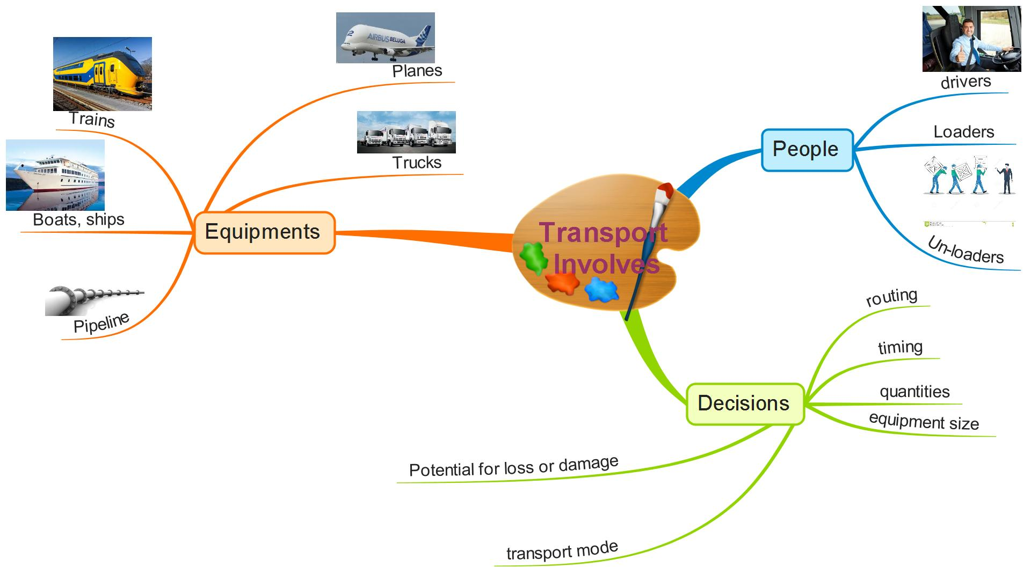
2. Transport involves TTP(cont.)

Slide 15
2. Transport Cost Characteristics (cont.)
Rail
High fixed costs, low variable costs
High volumes result in lower per unit (variable) costs
Highway
Lower fixed costs (don’t need to own or maintain roads)
Higher unit costs than rail due to lower capacity per truck
Terminal expenses and line-haul expenses
Water
High terminal (port) costs and high equipment costs (both fixed)
Very low unit costs
Air
Substantial fixed costs
Variable costs depend highly on distance traveled
Pipeline
Highest proportion of fixed cost of any mode due to pipeline ownership and maintenance and extremely low variable costs

Slide 16
2.Transport Cost Characteristics (cont.)
Fixed costs:
Terminal facilities
Transport equipment
Carrier administration
Roadway acquisition and maintenance [Infrastructure (road, rail, pipeline, navigation, etc.)]
Variable costs:
Fuel
Labor
Equipment maintenance
Handling, pickup & delivery, taxes

Slide 17
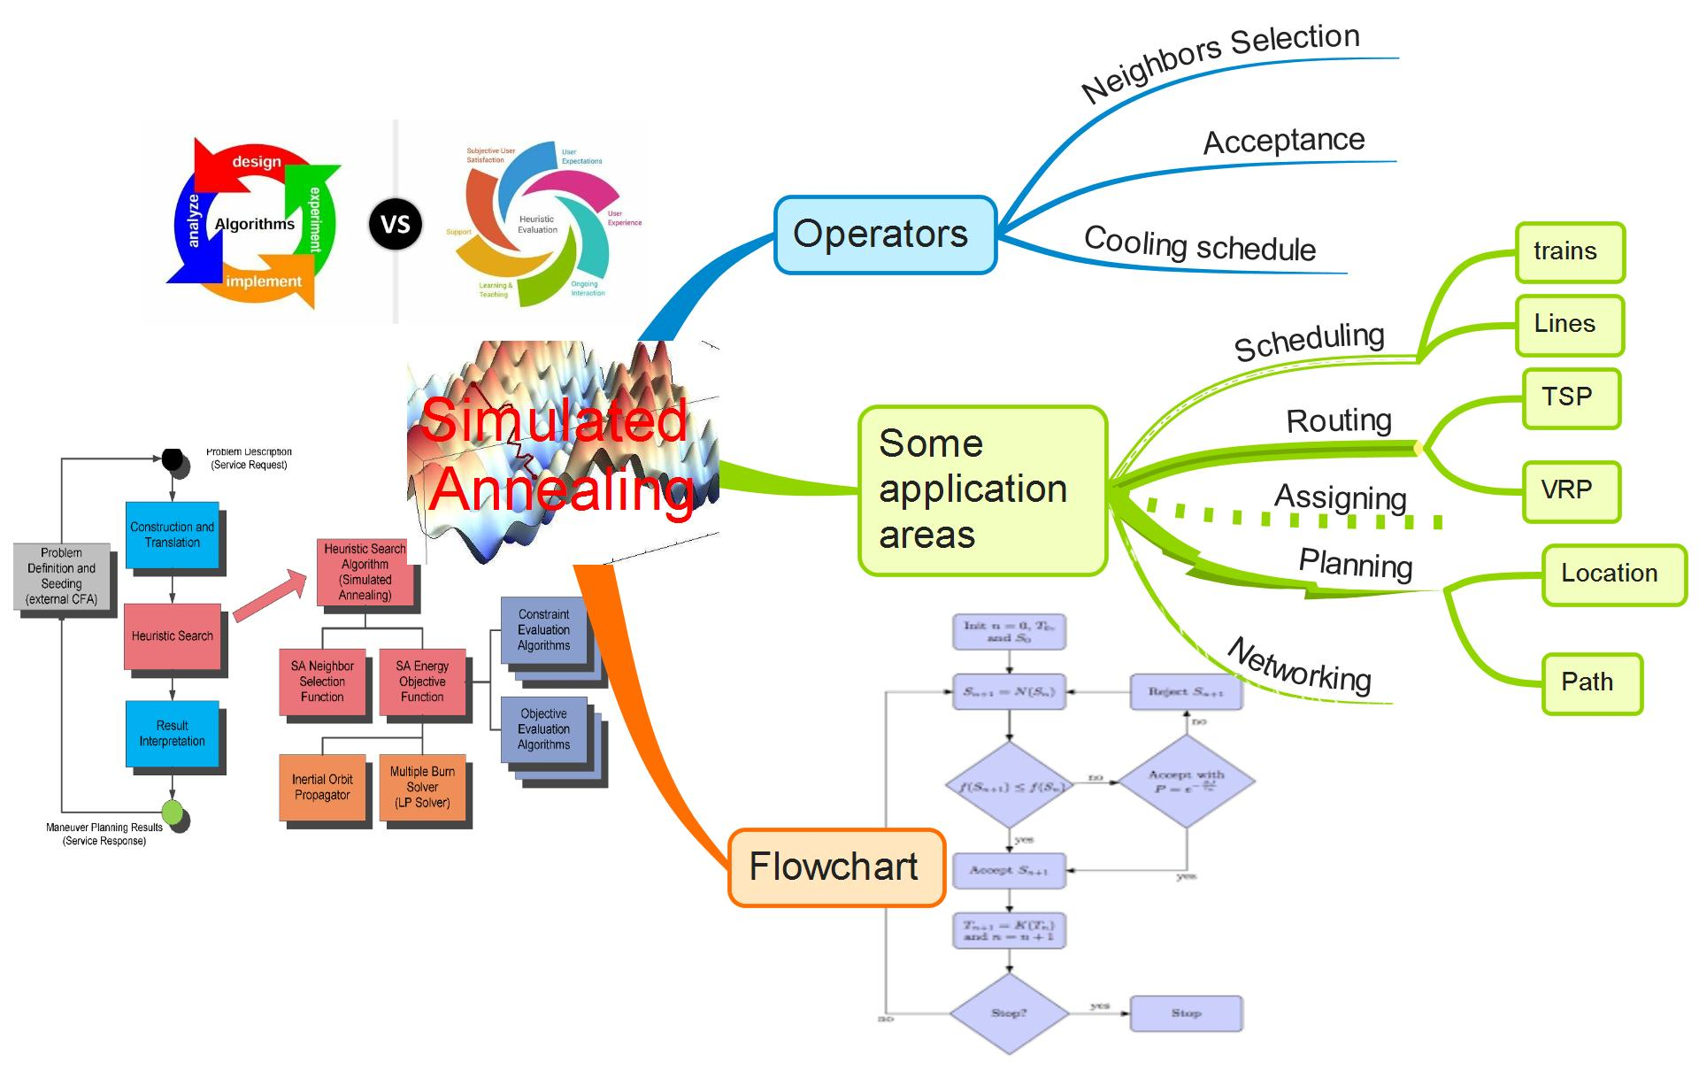
Simulated Annealing (SA) and its applications

Slide 18
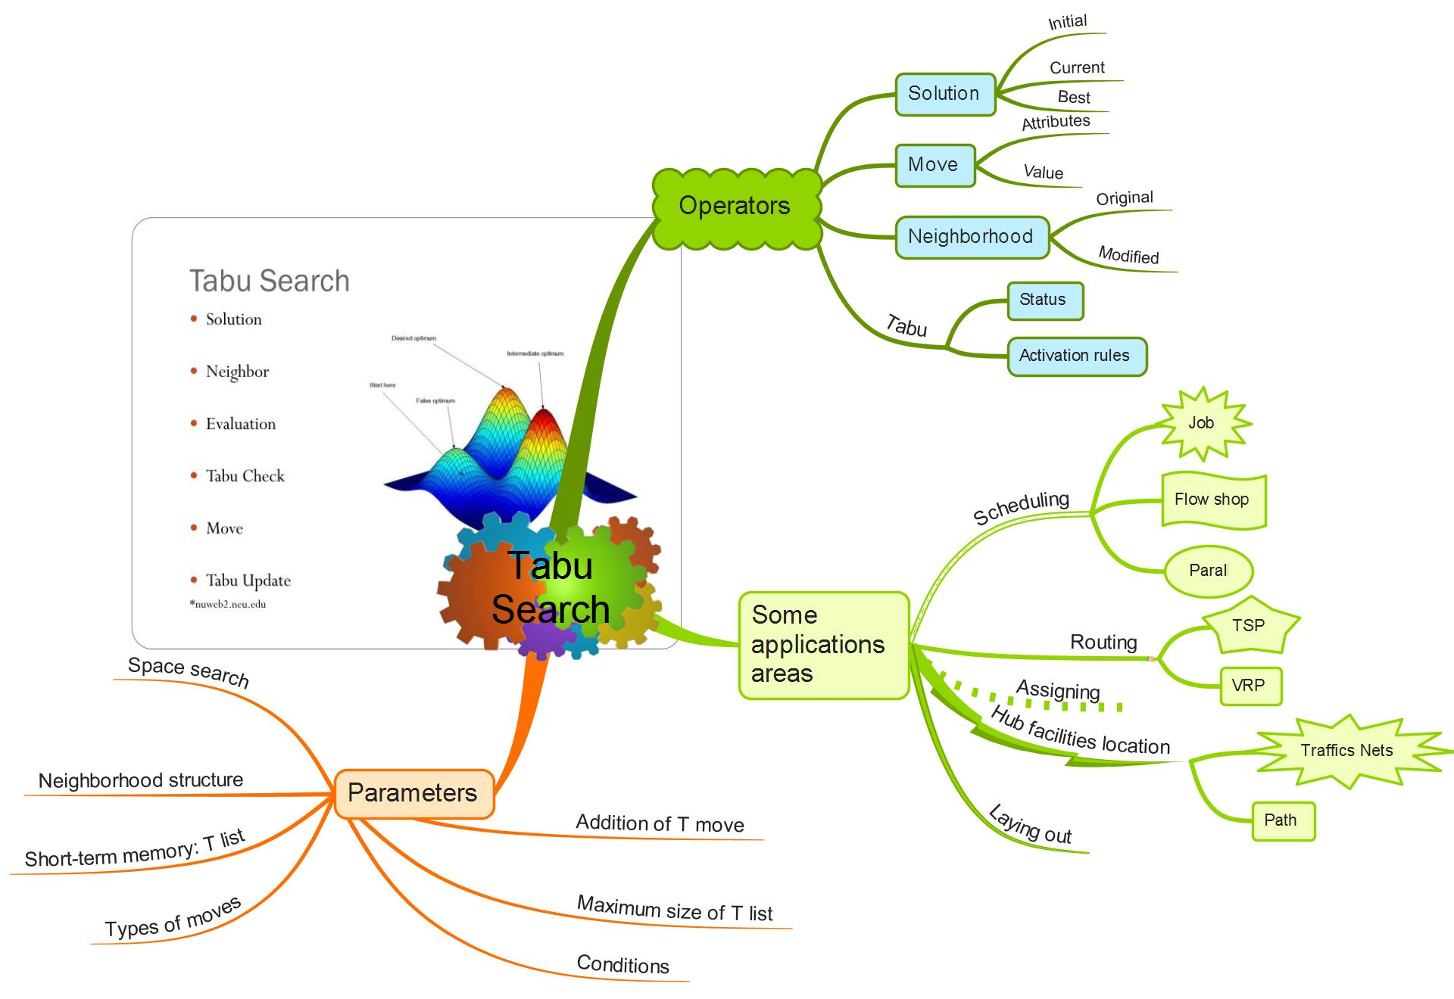
Tabu Search(TS) and its applications

Slide 19
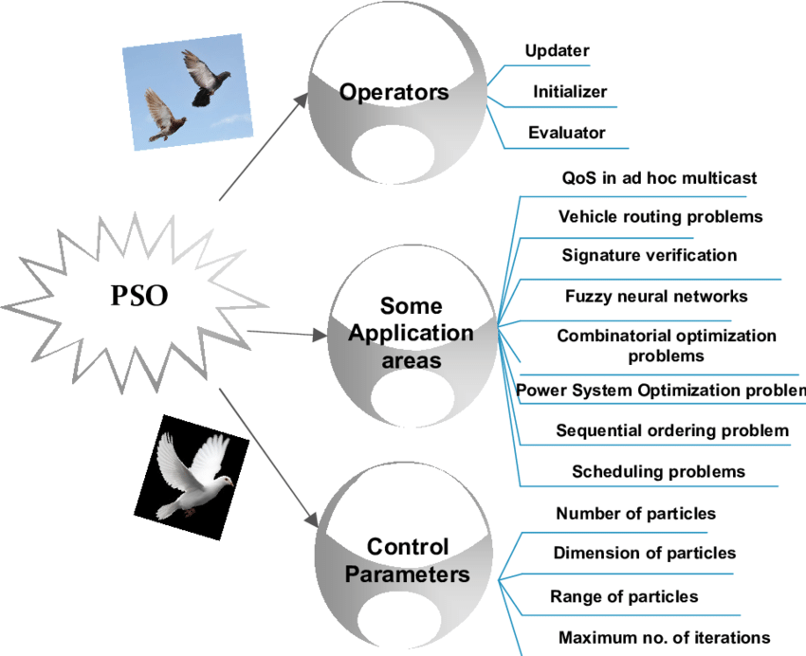
Particle Swarm Optimization (PSO)

Slide 20
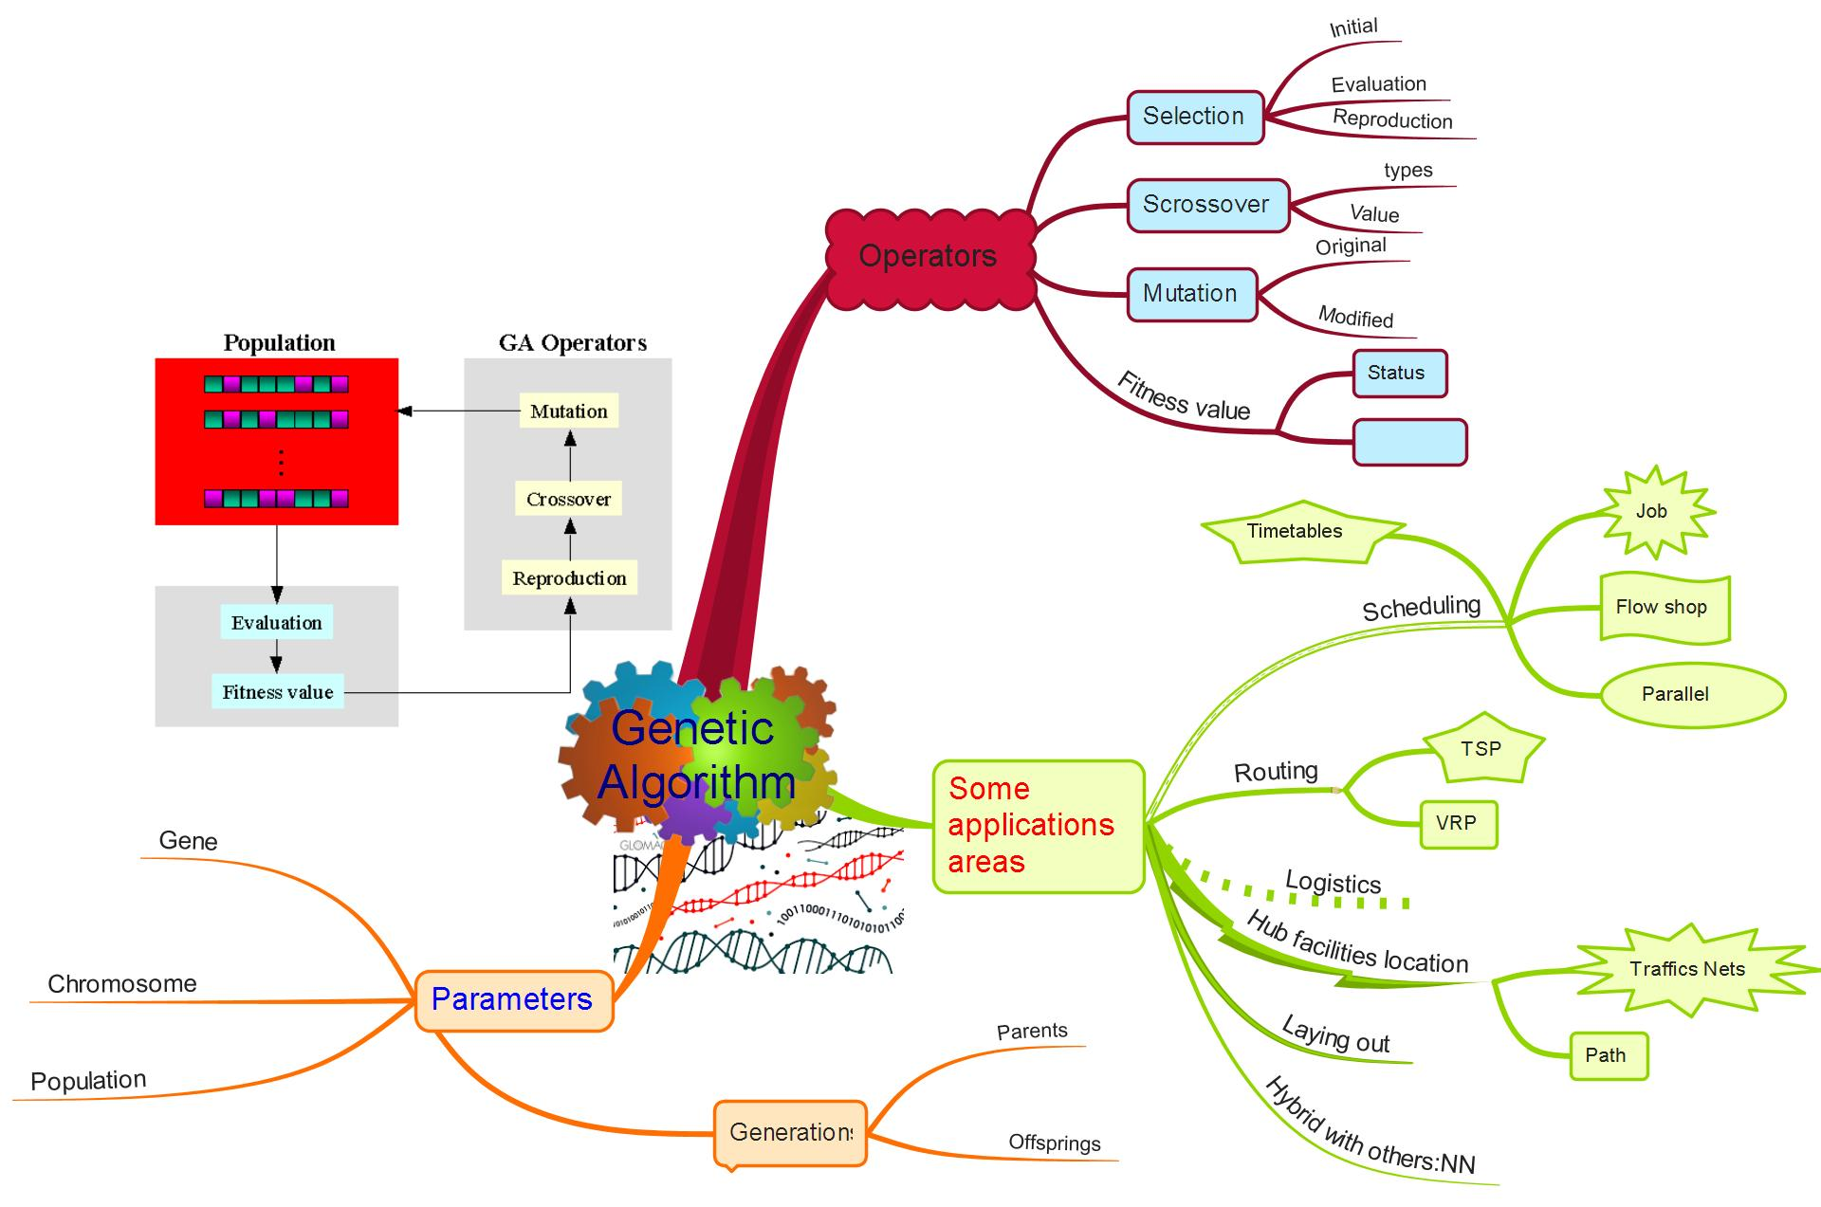
Genetic Algorithm GA)

Slide 21
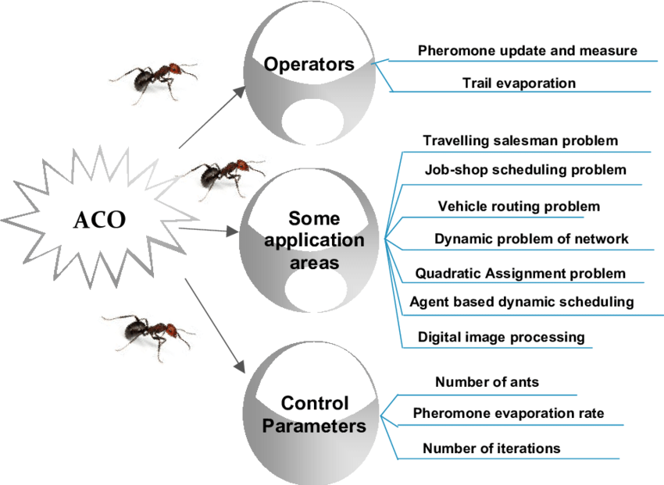
Ant colony optimization (ACO)

Slide 22
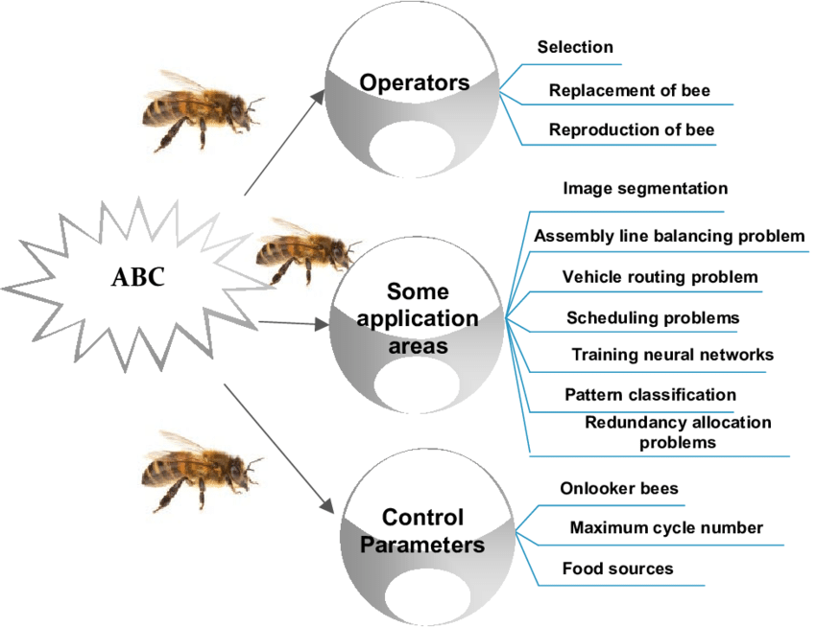
Artificial Bee Colony Algorithm (ABC)

Slide 23
3. Approaches CI to TTP

Slide 24
CI for Transportation (cont.)
Objective
Reliable delivery through low-cost/high-value services
Widely coordination of production and distribution
Cost reduction across supply chain
Attribute
Transportation - larger, faster
Information Systems
Logistics Innovations

Slide 25
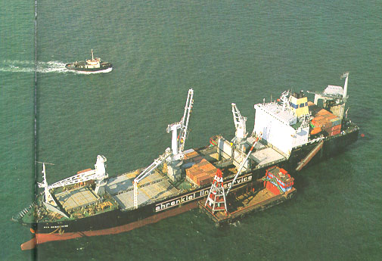
Routes of Goods
Air terminal
plane
air
Goods at shippers
Container terminal
sea
May change transpor-tation modes
Freight forwarder warehouse
vessel
sea
bulk goods
Freight forwarder warehouse
pier
mid-stream
land
barge
land
railway
Goods at consignees
truck

Slide 26
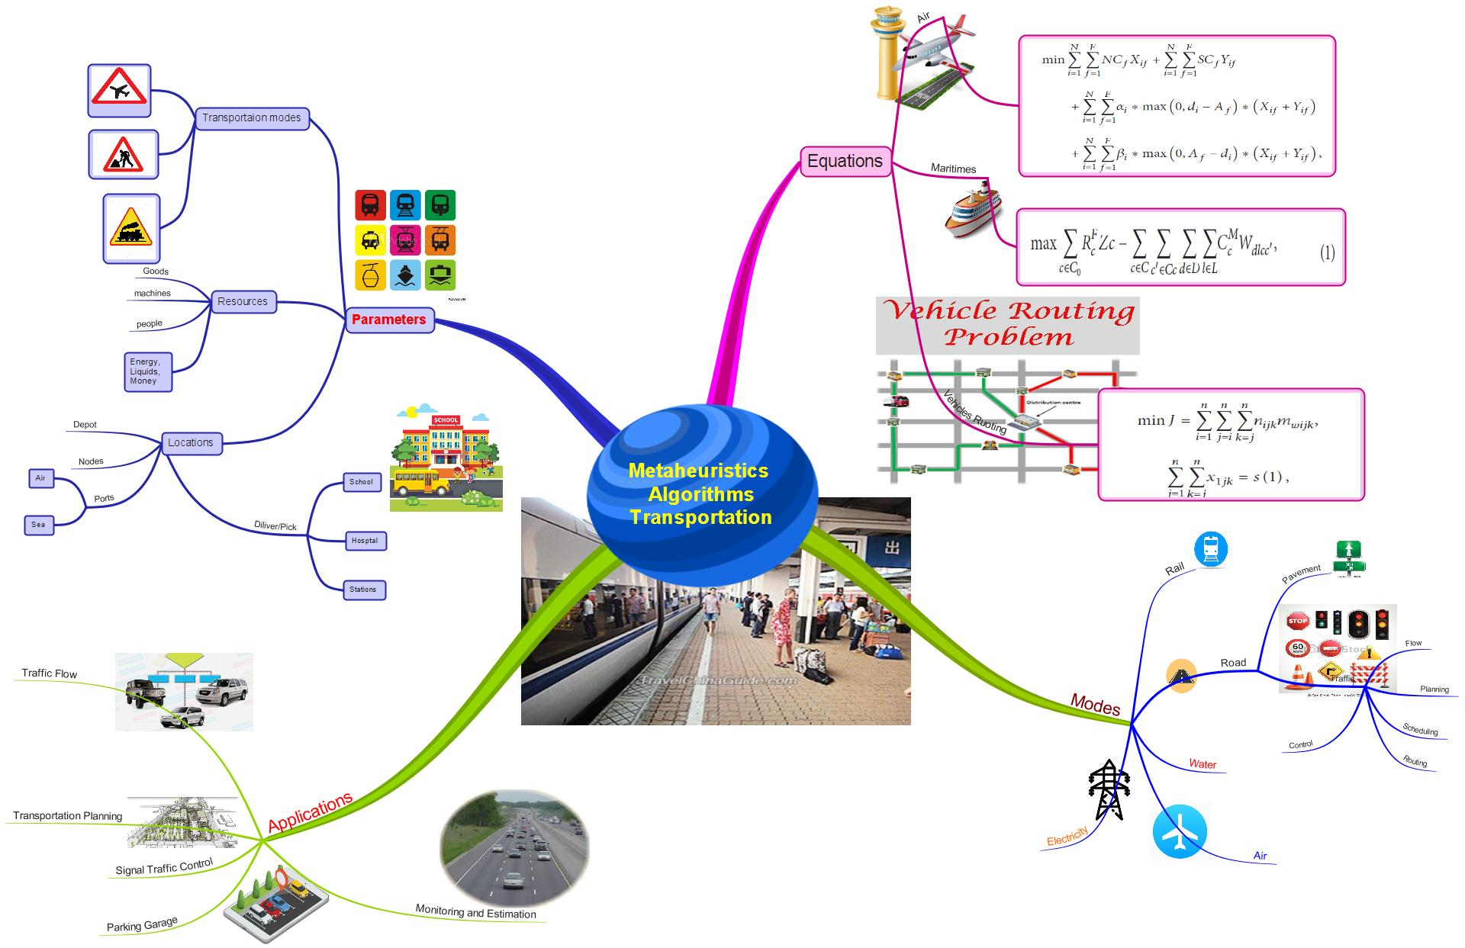
Metaheuristics for Transportation

Slide 27
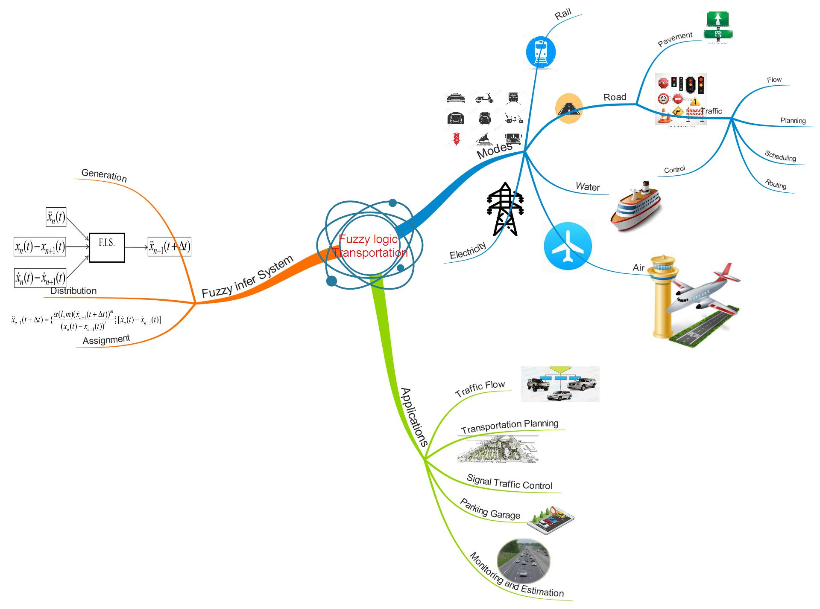
Fuzzy logic for Transportation

Slide 28
Example of Vehicle Routing
Find the best vehicle route(s) to serve a set of orders from customers.
Best route may be
minimum cost,
minimum distance, or
minimum travel time.
Orders may be
Delivery from depot to customer.
Pickup at customer and return to depot.
Pickup at one place and deliver to another place.

Slide 29
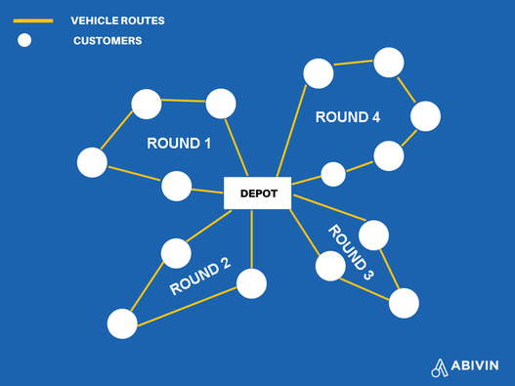

Slide 30
VRP Solutions
Heuristics
Construction: build a feasible route.
Improvement: improve a feasible route.
Not necessarily optimal, but fast.
Performance depends on problem.
Worst case performance may be very poor.
Exact algorithms
Integer programming.
Branch and bound.
Optimal, but usually slow and applicable for small size problem
Difficult to include complications.

Slide 31
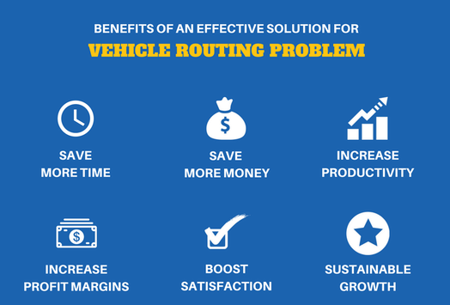
Benefits of VRP

Slide 32
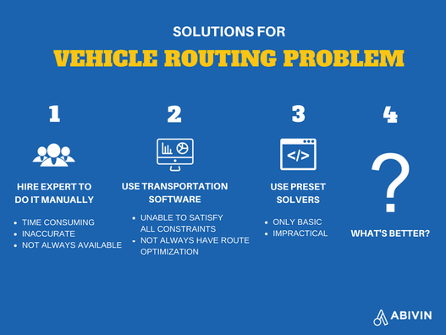
Solutions for VRP

Slide 33
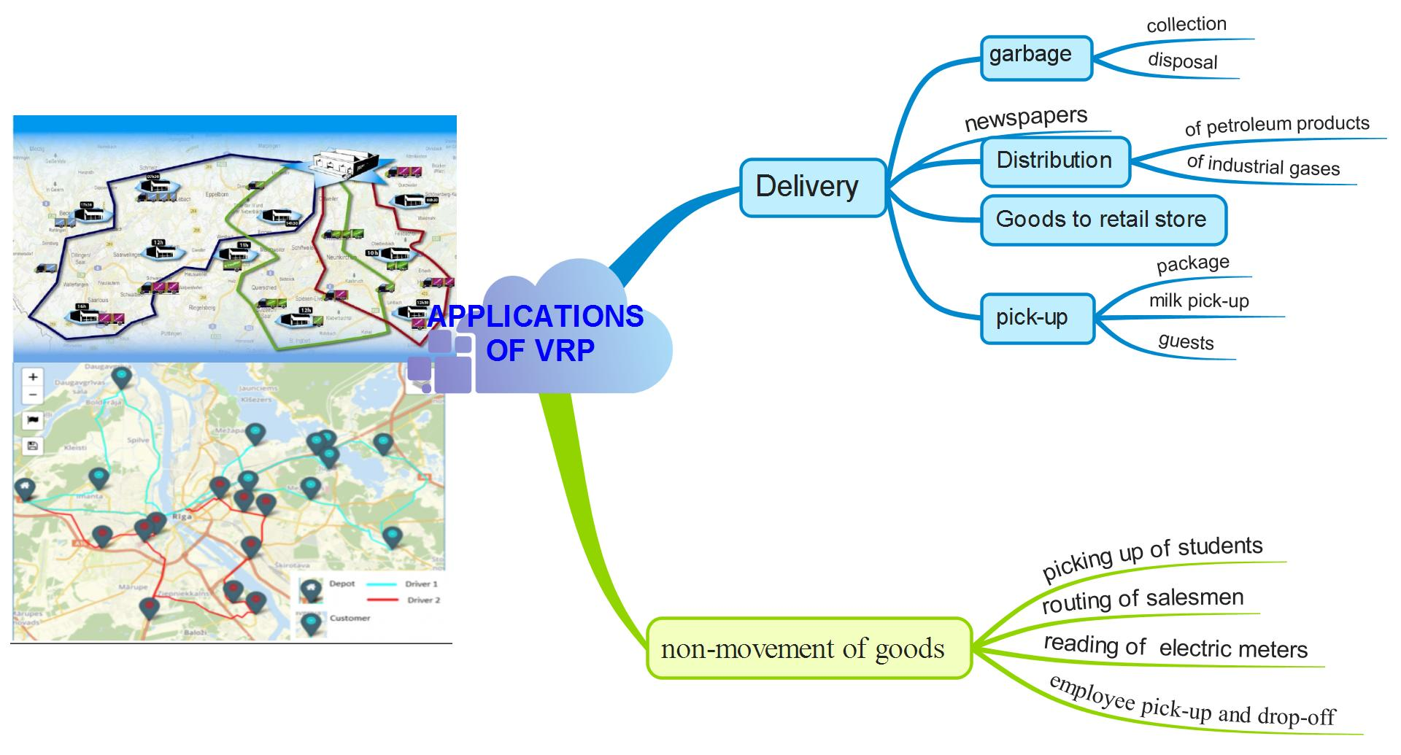
Applications of VRP

Slide 34
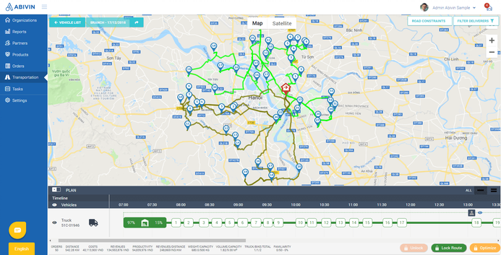
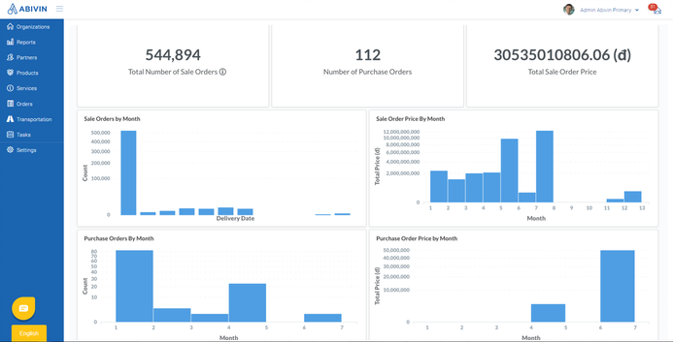
Example: Transportation Management System
DATA MANAGEMENT MODULE
✰ General file
✰ Depot Data File
✰ Vehicle Data File
✰ Pickup point Demand Data File
✰ Inter-Stop Distance Data File
MODEL MANAGEMENT MODULE
✰ Heuristic Procedures
✰ Simulation Model
REPORT MANAGEMENT MODULE
✰ Details of Route Sequence
✰ Summary of Routes
✰ Overall Summary of Routes
✰ Depot wise Route Allocation
✰ Vehicle Type wise Route Allocation
CONTROL MODULE
COMPUTER SYSTEM
USER

Slide 35
Vehicle Routing
Setup and Model.
Problem Variety.
Pure Pickup or Delivery Problems.
Mixed Pickups and Deliveries.
Pickup-Delivery Problems.
Backhauls.
Complications.
Simplest Model: TSP
Heuristics.
Optimal methods.

Slide 36
General Setup
Assign customer orders to vehicle routes (designing routes).
Assign vehicles to routes.
Assigned vehicle must be compatible with customers and orders on a route.
Assign drivers to vehicles.
Assigned driver must be compatible with vehicle.
Assign tractors to trailers.
Tractors must be compatible with trailers.

Slide 37
Model
Nodes: physical locations
Depot.
Customers.
Arcs or Links
Transportation links.
Number on each arc represents cost, distance, or travel time.
4
5
1
6
4
depot
3
8
6
8
4

Slide 38
Pure Pickup or Delivery
Delivery: Load vehicle at depot. Design route to deliver to many customers (destinations).
Pickup: Design route to pickup orders from many customers and deliver to depot.
Examples:
UPS, FedEx, etc.
Manufacturers & carriers.
Carpools, school buses, etc.
depot

Slide 39
Pure Pickup or Delivery
depot
depot
Which route is best????
depot

Slide 40
TSP & VRP
TSP: Travelling Salesman Problem
One route can serve all orders.
VRP: Vehicle Routing Problem
More than one route is required to serve all orders.
VRP
TSP
depot
depot

Slide 41
TSP Formulation
Minimize
Subject to:
In the TSP formulation if we remove the third constraint set we have the simple assignment problem, which can be easily solved.
The addition of the third constraint set, commonly called sub-tour elimination constraints, makes this a very difficult problem to solve.

Slide 42
Mixed Pickup & Delivery
Pickup
Delivery
depot
Can pickups and deliveries be made on same trip?
Can they be interspersed?

Slide 43
Mixed Pickup & Delivery
Separate routes
Pickup
Delivery
One Route
Not Interspersed
depot
Interspersed
depot
depot

Slide 44
Interspersed Routes
Pickup
Delivery
F
For clockwise trip:
Load at depot
Stop 1: Deliver A
Stop 2: Pickup B
Stop 3: Deliver C
Stop 4: Deliver D
etc.
I
E
H
D
K
ACDFIJK
A
G
J
CDFIJK
C
depot
L
B
BCDFIJK
BDFIJK
Delivering C requires moving B
BFIJK
Delivering D requires moving B

Slide 45
Conclusion
Computational Intelligence
really significant in
collaboration and
development for TTP

Slide 46
ThankYou

Slide 47
References
1. Billa, M. K. (2018). Secrets of the SAP Transportation Management Optimizer. Retrieved 2019, from https://novigo.com/blog/secrets-of-the-sap-transportation-management-optimizer
2. Descartes. (2017). Carrier Compliance & Rate Management. Retrieved 2019, from https://www.descartes.com/solutions/transportation-management/carrier-compliance-rate-management
3. DHL. (2018). FOUR WAYS TO INCREASE THE VALUE OF YOUR TMS. Retrieved 2019, from https://www.logistics.dhl/pl-en/home/our-divisions/supply-chain/thought-leadership/articles/four-ways-to-increase-value-of-tms.html
4. Gurusofttech. (2019). Logistics Management System: 3PL, WMS, TMS, OMS. Retrieved from https://www.gurusofttech.com/lms-logistics-management-system
5. Mei, J., & Eliot, M. (2017). THE IMPACT OF TRANSPORTATION MANAGEMENT SYSTEM ON SUPPLY CHAIN MANAGEMENT: THE EFFECTIVENESS OF CHINESE ONLINE SHOPPING DELIVERY–THE “KUAIDI” SYSTEM. European Journal of Logistics, Purchasing and Supply Chain Management, 5(2).
6. Stackpole, B. (2014). WMS-TMS integration brings clearer operational views. Retrieved 2019, from https://searcherp.techtarget.com/feature/WMS-TMS-integration-brings-clearer-operational-views
7. TMD Security GMBH. (2018). TMD Security intros TMS ATM Software jackpotting solution. Retrieved 2019, from https://www.atmmarketplace.com/news/tmd-security-intros-tms-atm-software-jackpotting-solution/
8. Transwide. (2019). Data gives your business the ability to analyse and identify new opportunities. Retrieved 2019, from https://www.transwide.com/en/transport-management-system/reporting-analytics/

